Slide 1
A2512 Concept Candidate 2 Car Underseat Subwoofer
2025-11

Slide 2
Strategic Context
Our Mission: To leverage our core B2B strengths in acoustics, haptics, DSP, and AI to build a new, high-growth B2C Consumer Electronics business pillar.
Initial Position: Established Chinese B2B automotive supplier with deep engineering expertise and OEM customer base in China.
Strategic Intent: Transition to a B2C model to capture higher growth and valuation.
Primary Goal: Achieve a $10M ARR run-rate within 2 years.
Key Challenge: Navigating the shift from a spec-driven B2B world to an emotion and experience-driven B2C market.

Slide 3
Why the US Car Aftermarket?
It's a massive, stable, and growing market that perfectly aligns with our capabilities and strategic goals.
Market Size: ~$400 Billion for the light-duty vehicle aftermarket
Key Driver: Record-high average vehicle age of 12.8 years
The 'Sweet Spot': This creates a huge population of vehicles outside of factory warranty, whose owners are prime candidates for repair, maintenance, and high-value upgrades.

Slide 4
User Segment: DIY Prosumer
结合我们短期内缺少美国本土线下店渠道资源的现状，优先target DIY人群
DIY Market: Represents ~22% of product volume and is growing, especially among younger consumers (ages 18-44)
Who is the 'Prosumer'?
Hands-on & Passionate: They enjoy working on their vehicle as a hobby
Quality-Conscious: They are willing to pay more for quality, reliability, and a guaranteed result
Driven by Accomplishment: The feeling of successfully completing an upgrade is a primary motivator

Slide 5
典型心理之一：Confidence Gap
The 'Confidence Gap' is caused by five consistent failures of current aftermarket products.
1. The 'Plug-and-Play' Myth: Marketing promises simplicity, but the reality is a complex, multi-hour ordeal of vehicle disassembly.
2. Instructional Failure: Vague, generic instructions are the #1 complaint, forcing users to rely on YouTube and forums.
3. Component Incompatibility: The 'gotcha' moment when a part doesn't fit a specific trim level or work with a factory system.
4. Safety & Warranty Anxiety: The potent fear of interfering with airbags or voiding a warranty is a primary purchase deterrent.
5. The 'Last 10%' Problem: The difficulty of achieving a perfect, factory-like fit and finish, which separates a proud success from a disappointing amateur effort.

Slide 6
User Segment: Leased Vehicle Owner
画像
34-44 y.o., $7.3w annual income, higher than average income households
千禧一代（1981-1996）中1/3 lease 而非购买
urban & suburban
典型心理
"affordable premium": 提前消费, tech-forward&feature-driven, risk aversion
"temporary owner"
"safety & warranty anxiety"
车型分布
SUV, EV
多数lease入门级trim level（配置版本）
参考
https://gemini.google.com/app/17857eae08fe6001
https://chatgpt.com/share/69081bb6-f4c8-8002-9fca-f7c55d752afa

Slide 7
美国车主围绕 车 vs 手机的使用习惯
车 vs 手机
主流应用：老三样
Android Auto和CarPlay为主
都是USB接口为主、wifi/蓝牙为辅基础上的“投影”协议
手机端进行所有的联网、计算等，合成视频流传输到车机屏幕
车机屏幕接收触控、按键等事件，传输到手机
80-90%用户直接忽略车机，只用AA/CP
2024年开始GM在新的EV车型中去掉AA/CP，强推车机
导航
音乐
播客/有声书

Slide 8
Target Platform: iOS dominates
iOS Dominates the General US Market
Apple holds the majority share of the US mobile market (~58-59% of all users).
This lead is even stronger in new sales (~57-65%), ensuring our target market is growing.
A "Systematic Bias" That Favors Us
The market share is even more skewed toward iOS within our specific target demographic.
Enthusiast Owners: The "modding" community for popular vehicles (e.g., Jeep Wrangler, Subaru WRX, Ford Mustang) shows a strong preference for iOS.
Perfect Alignment with the "DIY Prosumer"
The typical iOS user profile (younger, higher-income, higher spending on premium apps/accessories) is a near-perfect match for the "DIY Prosumer" who is "willing to pay more for quality".
Strategic Conclusion
Focus: Prioritize a flawless CarPlay-integrated experience first. This targets the largest, wealthiest, and most motivated customer segment.
Roadmap: Position Android Auto support as a "fast follow" after we have successfully captured and secured the primary iOS market.

Slide 9
Concept v0.1
For CarPlay Users: Finally Add Real Bass, Truly 0 Drilling, Cutting, and Screwing.
You want to upgrade your car's weak factory audio, but you're not willing to rip apart your dashboard or splice into factory wiring just to add a subwoofer. The installation is too complex, too risky, and too expensive, especially on a new or leased vehicle.
Our "Smart-Link" Subwoofer System is the solution. It's the first truly DIY, high-performance bass system designed for modern cars. It delivers the "chest-thump" and "in-your-seat" impact of a high-end system, but installs in 20 minutes with **no audio wires to run.**
The Smartest, Easiest Install:
The "Smart-Link" Module: This smart module plugs in between your phone and your car's CarPlay USB port. It intelligently intercepts the digital audio stream *before* it gets to your factory stereo.
The "Smart-Link" Subwoofer: The compact, powered subwoofer fits under your seat and connects *only* to your car's 12V power. That's it.
Perfectly Synced, Wirelessly: The module instantly processes the audio and sends the deep bass signal to the subwoofer wirelessly, using our high-fidelity, latency-free link. The bass is perfectly in sync with your main speakers.
Stop just hearing your music. Start feeling it, without touching a single factory wire.

Slide 10
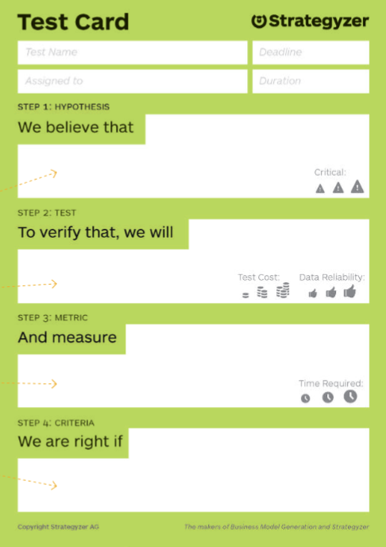
Do they want this? Test Card - Search Trend Analysis
Step 1 Hypothesis | We believe that | A significant and motivated segment of "DIY Prosumer" and "Leased Vehicle Owner" customers wants to upgrade their factory car audio (specifically to add bass), but is blocked by a "Confidence Gap" and "Safety & Warranty Anxiety". They are actively searching for a non-invasive, 100% reversible, "warranty-safe" solution.
Step 2 Test | To verify that, we will | Conduct a keyword trend analysis to find "problem-aware" search terms. Analyze search volume and commercial intent (CPC) for terms related to adding subwoofers to leased vehicles or without modification. Perform qualitative analysis of user discussions in target forums to confirm the "why" behind their search.
Step 3 Metric | And measure | Quantitative (Search): Monthly Search Volume (MSV) and Cost-Per-Click (CPC) for keyword clusters like: Lease-specific: "subwoofer for leased car," "add sub to lease," "warranty safe subwoofer". Non-invasive: "no wire subwoofer," "removable subwoofer," "add sub without cutting wires," "plug and play subwoofer". Qualitative (Forums): The frequency and sentiment of posts expressing fear of voiding warranties, cutting wires, or failing the "Last 10%" fit-and-finish test.
Step 4 Criteria | We are right if | We find substantial search volume (e.g., >10,000 combined MSV) for these "problem-aware" keywords, indicating a valid market. We are further validated if the CPC is moderate-to-high (showing commercial intent) and if qualitative forum analysis confirms that installation risk , not product cost, is the primary purchase barrier.

Slide 11
相关用户讨论
"Is there anyway to add an amp/sub without a LOC. I have a leased vehicle I can't modify."
https://www.reddit.com/r/CarAV/comments/1o90e74/is_there_anyway_to_add_an_ampsub_without_a_loc_i/
"Subwoofer in a leased MME"
https://www.reddit.com/r/MachE/comments/1ealacq/subwoofer_in_a_leased_mme/
"Can I install a subwoofer in a leased car?"
https://www.reddit.com/r/cars/comments/5qyzvn/can_i_install_a_subwoofer_in_a_leased_car/
"Subwoofers in a leased vehicle"
https://www.reddit.com/r/CarAV/comments/bxymt8/subwoofers_in_a_leased_vehicle/
"I'm not allowed to make any modifications to the Explorer... I don't want to install a LOC just to rip it out a few months later."
"I'm wanting to install a removable subwoofer in my '23 MME Premium but wary of voiding the warranty... on a lease vehicle."
"As long as you can remove it and leave absolutely no evidence behind you did it, then you should be fine."

Slide 12
相关用户讨论
"putting subs in a leased car..."
https://forum.polkaudio.com/discussion/33546/putting-subs-in-a-leased-car
"Best options for upgrading a Leased car audio?"
"This is a terrible idea, because you're going to have to modify the current system, and that will violate your lease. Don't do it."
https://www.reddit.com/r/CarAV/comments/3m2ogy/best_options_for_upgrading_a_leased_car_audio/
"I leased mine and can't believe how weak the sound is. I have Focal speakers from my old truck, Fosgate amps and subs and would love to use them on this truck, but I can't butcher the wiring up too bad. Any suggestions?"
https://www.chevyzr2.com/threads/bose-audio.1846/page-3
"A custom paint job or aftermarket speaker components that require cutting into the car's wiring harness are almost certainly a no-go on a leased vehicle."
https://www.capitalone.com/cars/learn/managing-your-money-wisely/can-you-modify-a-leased-car/1587

Slide 13
Leased vehicle owner 现有的解决方案对比
Attribute | Traditional Install (Amp + Sub) | "Lease-Friendly" (T-Harness + Powered Sub) | JBL BassPro Go | Concept A2512 (Smart-Link)
Invasiveness | High (Wire splicing, drilling) | Medium (Panel removal) | Medium-High (Battery wire, chassis ground, screw-in dock) | None
Reversibility | Low (Permanent changes) | High (but requires re-work) | High (but leaves screw holes) | 100% / Instant
Installation Time | 2-4 Hours (Professional) | 1-2 Hours (DIY/Pro) | 1-2 Hours (DIY/Pro) | < 20 Minutes (DIY)
Required Tools | Extensive (Drill, wire strippers) | Panel tools, socket set | Panel tools, drill, socket set | None
Perceived Risk (for Lessee) | Very High (Voids warranty/lease) | Moderate (Fear of damage/detection) | High (Requires running wires, drilling) | Very Low
Power Source | Car Battery (Hardwired) | Car Battery (Hardwired) | Car Battery (Hardwired) | 12V Power Outlet
Signal Source | Head Unit (RCA/Speaker Wires) | Factory Harness (T-Harness) | Speaker Wires (High-Level) | CarPlay/Android Auto (Wireless)
https://gemini.google.com/app/17857eae08fe6001

Slide 14
Search Trend Analysis
Prepare
- Identify what tools to use (Google Trends, Google Keyword Planner, etc.)
- Define a geographical area for your search.
- List the topics you want to explore such as:
- people trying to solve for customer jobs.
- individuals needing to address a customer pain.
- people wanting to create a customer gain.
- customers who are unhappy with an existing solution.
Execute
- Search for phrases related to your topic.
- Take screenshots and export your results.
- Write down notes along-side your research on what surprised you.
Analyze
- Gather your findings.
- Consider focusing on problem size over market size. What has the highest search volume on a typical problem? Would that be a meaningful business opportunity for you?
- Select the top 1-3 volume searches you want to explore in more detail in upcoming experiments.

Slide 15
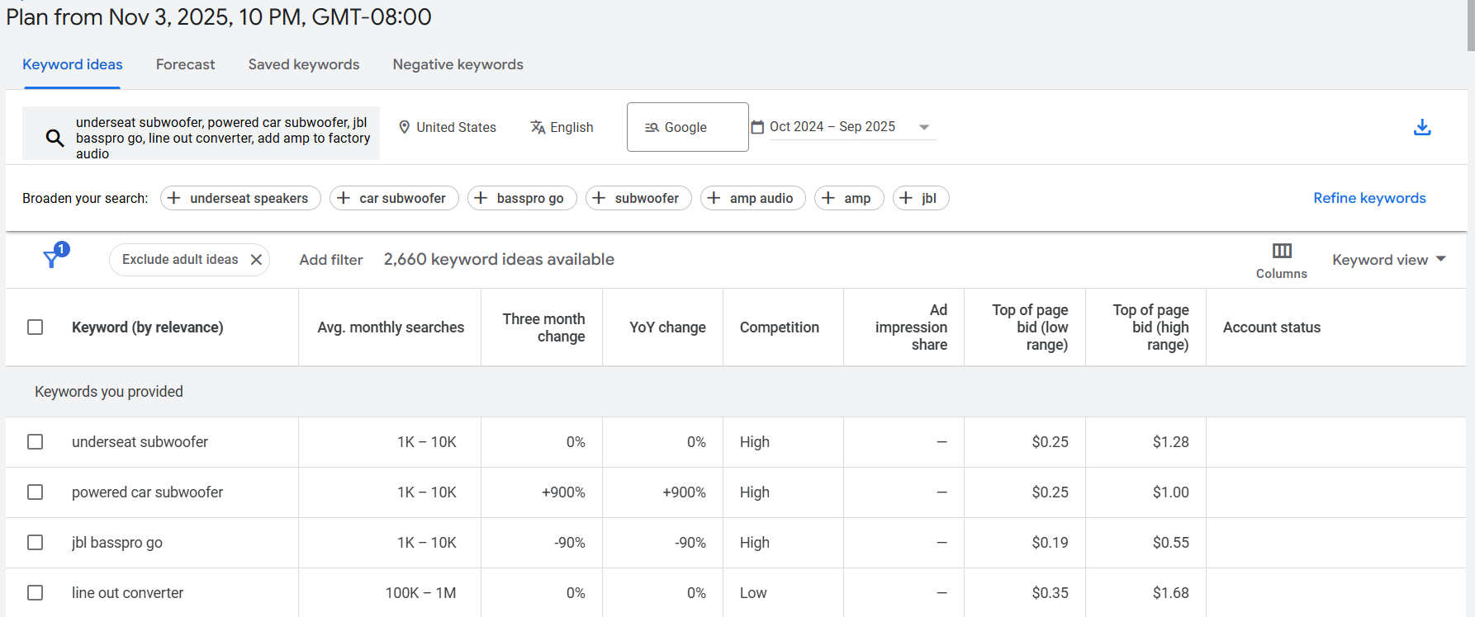
Finding 1: The "Solution" Market is Valid. Keywords like underseat subwoofer, powered car subwoofer, and compact car subwoofer all have strong monthly search volumes (1K - 10K each), high competition, and solid CPCs (up to $1.28). This confirms a large, healthy, and established market.
Finding 2: The "Bottleneck" Market is MASSIVE. This is the most important insight on the page. The keyword line out converter has a massive 100K - 1M average monthly searches. This is 10 times larger than the search volume for the end-product (underseat subwoofer).
Finding 3: Competitor Concept is validated. JBL BassPro Go also has meaningful search volume.

Slide 16
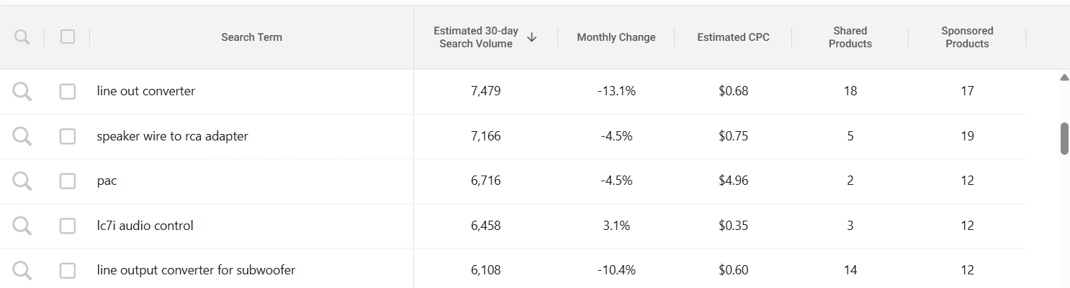
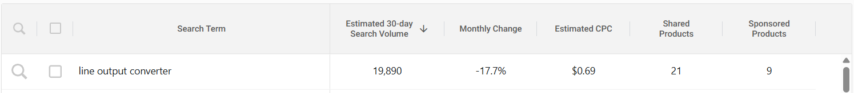
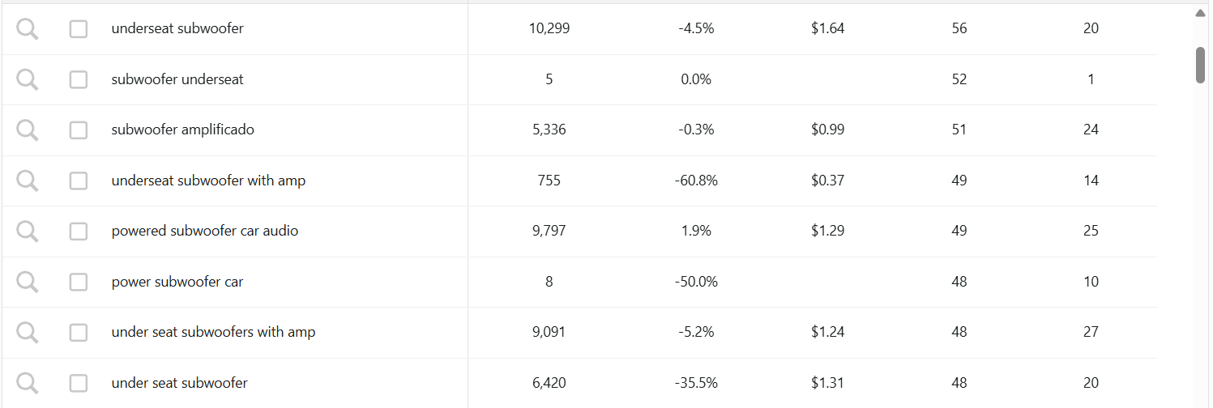

Slide 17
Continue Trying Finding "Golden Ticket Keywords"
After "underseat subwoofer" keyword, in the "Add filter" section, type in the following words:
plug and play
easy install
no cut
no splice
removable
quick connect
Result: no such "golden ticket" keywords in the keyword ideas list, people are not "solution-aware"
Finding
The "Problem" Market is Massive: We know from our previous step that line output converter gets 10,000 - 100,000 searches per month. This is your true target market. These are the "DIY Prosumers" who are actively trying to solve the installation problem and are getting stuck. They are searching for the problem, not the solution.
The "Solution Category" Market is Large: We also know underseat subwoofer gets 1,000 - 10,000 searches per month. These are the "General Consumers" who want the product but haven't yet discovered the "Confidence Gap" (the installation nightmare).
The "Ideal Solution" Market is Empty: zero people are searching for "plug and play subwoofer" or "easy install sub."

Slide 18
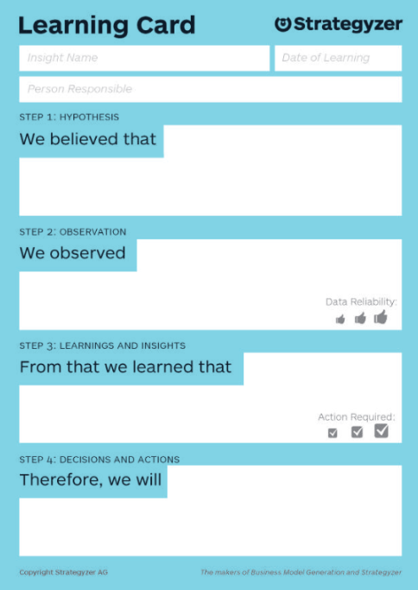
Do they want this? Learning Card - Search Trend Analysis
Step 1 Hypothesis | We believe that | A significant and motivated segment of "DIY Prosumer" and "Leased Vehicle Owner" customers wants to add bass to their car but is blocked by the risk and complexity of traditional, invasive installations.
Step 2 Observation | We observed | There are numerous, highly specific user discussions on Reddit and forums from people desperately seeking a solution to add a subwoofer to a leased vehicle without modifications. The "Car Audio Subwoofers" market is large and established (approx. $4.2M/month). Crucially, the "Car Audio & Video Input Adapters" market—a proxy for users trying to connect to their factory system—is even larger (approx. $4.6M/month). The market for "wireless CarPlay adapters" and "line out converter" is massive, with top keywords having 184k+, 107k+, and 63k+ monthly searches on Amazon. On Google, 1-10K search "underseat subwoofer", 100K-1M search "line out converter"
Step 3 Learnings and Insights | From that we learned that | The core problem is validated. The target user is actively seeking a solution that does not exist. The "Leased Vehicle Owner" is a highly motivated and currently unserved customer segment. The ideal solution market is empty.
Step 4 Decisions and Actions | Therefore, we will | Shift Focus: Shift primary focus to "Can we build this?" by prioritizing technical validation of the CarPlay/AA audio interception and the 12V non-invasive power solution. Refine Segment: Formally validate the "Leased Vehicle Owner" and "DIY Prosumer" with a "Confidence Gap" as our primary, high-value target segments.

Slide 19
Do they want this? Leased Car要求、数量、人群
要求
一般情况下leased vehicle不允许进行power、headunit、audio线的任何破坏性连接，多数leased vehicle车主无法加装underseat subwoofer等
数量
美国2023-2024年整车年销量月15.7million，leased数量约3-4million
典型lease合同期为3年，推算leased vechile保有量~10million
人群
young, tech/music enthusiasts
urban, compact-car and EV drivers
owner of mainstream/entry trims
参考
https://gemini.google.com/share/17b93a68a348
https://chatgpt.com/share/69080f22-7f2c-800d-9a46-310d520e9981

Slide 20
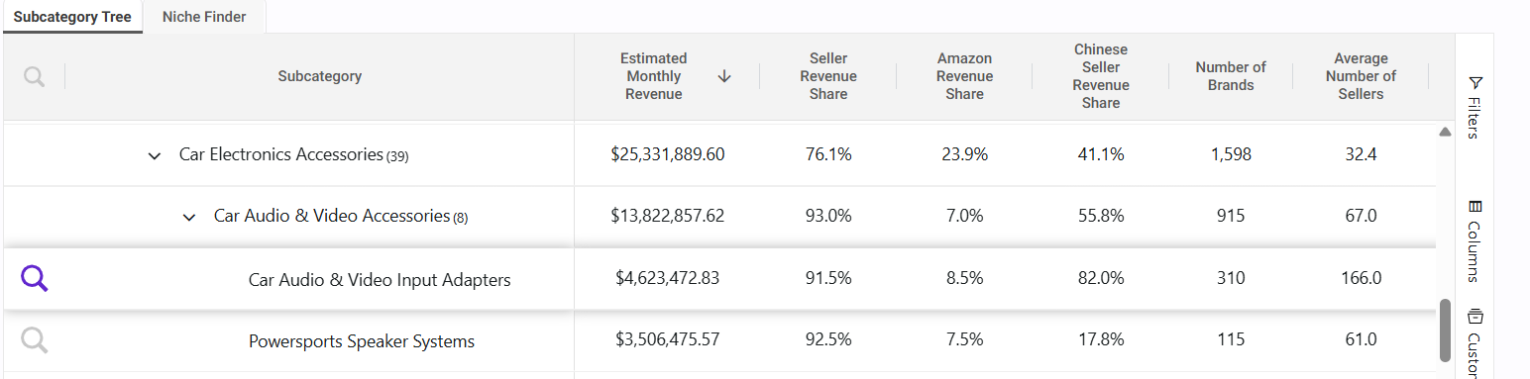
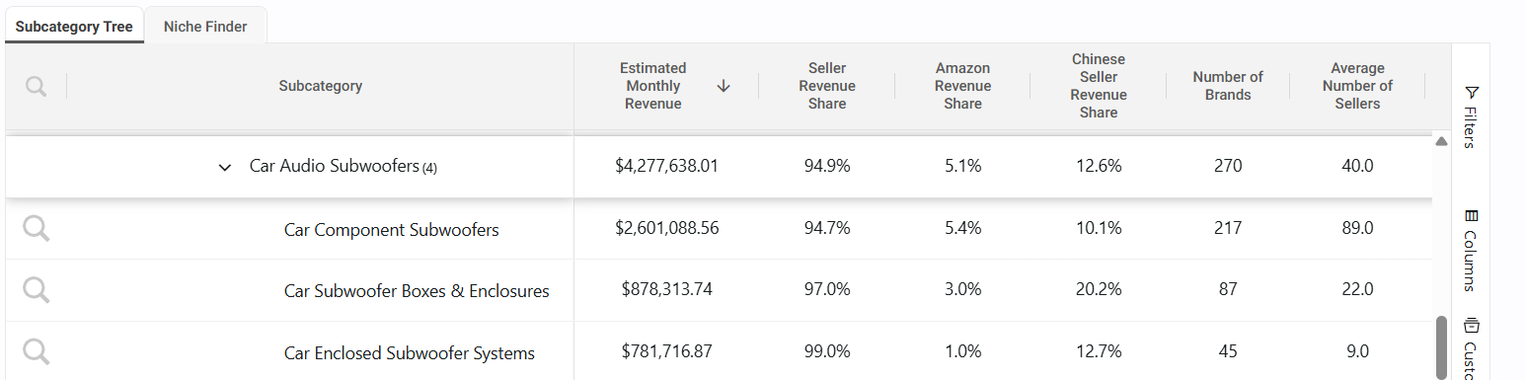
Do they want this? 相关产品销量数据分析
Car Audio & Video Input Adapters
$4.6M/月
11万件/月
均价$37
Car Audio Subwoofers
$4.2M/月
2.7万件/月
均价$230

Slide 21
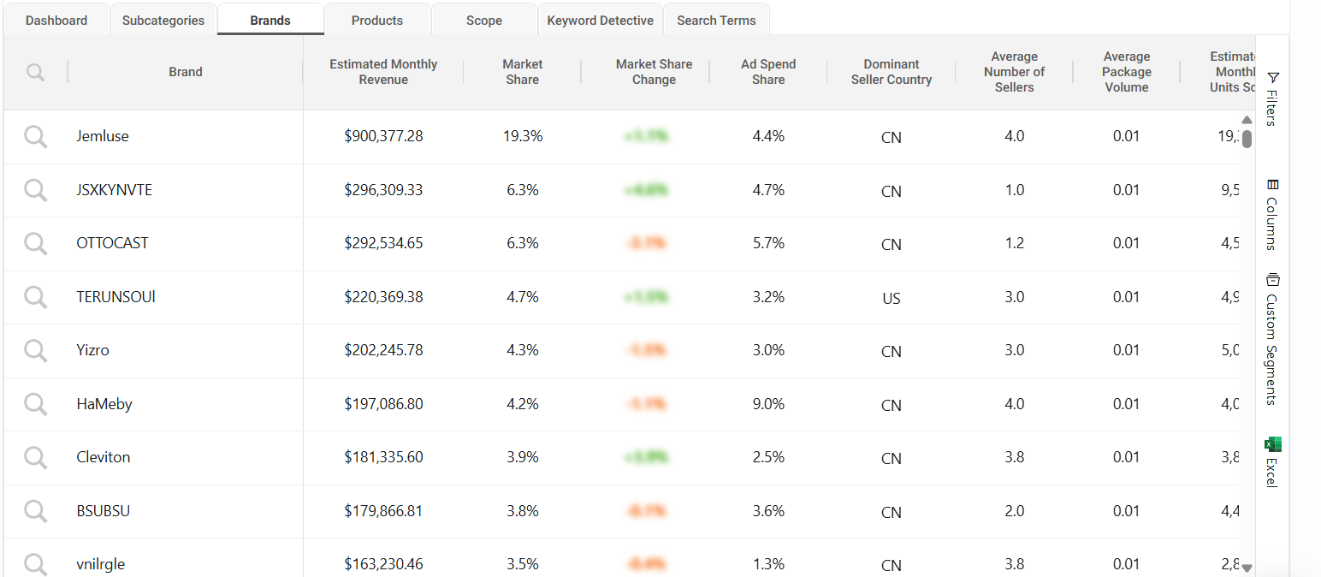
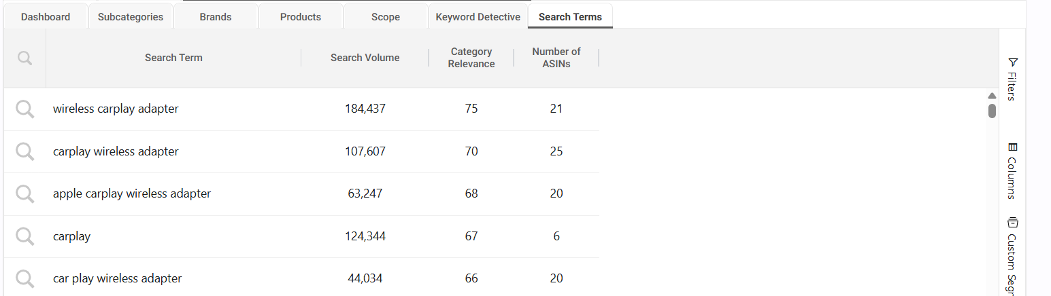
Do they want this? 相关产品销量数据分析

Slide 22
Can we build this? 拦截CarPlay/Android Auto信号的可行性
Android Auto 可行，在aa-proxy-rs项目中明确支持MITM Man-In-The-Middle mode
[📱 Android Phone] ⇄ [📶 BT+WiFi] ⇄ [📟 RPi with aa-proxy-rs] ⇄ [🔌 USB] ⇄ [🖥️ Car Headunit]
CarPlay，可行但工作量/单机成本可能高些
https://gemini.google.com/app/f8ea59b1837b1a10
https://chatgpt.com/share/69073fc1-c634-8002-b1b1-eba52602c365
https://claude.ai/chat/c550a2bf-6810-4fdc-9d6b-cddb3d129135
DIY项目参考
https://github.com/aa-proxy/aa-proxy-rs
https://github.com/rhysmorgan134/react-carplay
https://github.com/ludwig-v/wireless-carplay-dongle-reverse-engineering
https://github.com/nisargjhaveri/WirelessAndroidAutoDongle

Slide 23
Can we build this? 拦截蓝牙音频信号的可行性
可行，在A2510项目中通过 2个 ESP32-WROVER-E 模组试验调通

Slide 24
Can we build this? 结合induction speaker思路
TODO：备选思路，用于“无损”、“快速方便”地从原车音响系统提取音频信号，用于新增产品的音频信号输出方式补充

Slide 25
Can we build this? 供电：基于电池提供能量缓冲
典型cigarette lighter供电功率范围 85-190W（https://claude.ai/share/60736a15-3557-4a56-9316-93478d0c2f8f）
典型underseat subwoofer输入功率需求范围 RMS 120W Peak 200W
TI 车用功放参考设计 https://www.ti.com/tool/PMP11769
TI BQ24773, Supplement Mode, JBL PartyBox 110
设计初稿：
https://gemini.google.com/app/9273e6dd6fded7f2
https://gemini.google.com/share/084207864cbc
https://gemini.google.com/app/5bda573628f4fca6
Vehicle Type | Common Rating | Theoretical Max | Safe Continuous
Compact Cars(Civic, Corolla) | 10A | 120W | 85-95W
Compact SUVs(RAV4, CR-V, Rogue) | 15A | 180W | 125-145W
Mid-size(Camry, Tucson) | 15A | 180W | 125-145W
Full-size Trucks(F-150, Silverado, Sierra) | 20A | 240W | 170-190W
EVs(Tesla Model Y) | 20A | 240W | 170-190W

Slide 26
Can we build this? 供电：基于电容进行能量缓冲
TODO：如果需要沿该路径设计开发，可以先参考如下资料
How to quickly and safely charge supercapacitors? https://www.ti.com/lit/an/sluaao7/sluaao7.pdf
TI BQ24640 datasheet https://www.ti.com/lit/ds/symlink/bq24640.pdf
Peak Power Contr ower Control of Batter ol of Battery and Super-capacitor Energy Systems in Electric Vehicles https://www.cmu.edu/traffic21/pdfs/peak-power-control-of-battery-and-super-capacitor-energy-systems.pdf
Ideal Diode/OR-ing controller https://www.ti.com/product-category/power-management/power-switches/ideal-diodes-oring-controllers/overview.html
How to use supercapacitors https://www.we-online.com/catalog/media/o157040v410%20AppNote_SN009_EN.pdf
Patent US7239206：amp内升压后，电容提供0.5s内8倍提高电流输出的补充；20个 2.7V 300F 电容串联后形成 54V 15F
https://patentimages.storage.googleapis.com/32/a3/09/c12c0e87d51668/US7239206.pdf
Patent US11594955：amp内声压后，电池提供（0.2s, 0.5s, 1s）10倍提高电流输出的补充，用户可以旋钮调节1-10级
https://patentimages.storage.googleapis.com/a0/d9/55/d4cf50e9bef24c/US11594955B2.pdf
Patent WO2024020580 https://patentimages.storage.googleapis.com/e8/a1/94/2bf3b438f01abd/WO2024020580A1.pdf

Slide 27
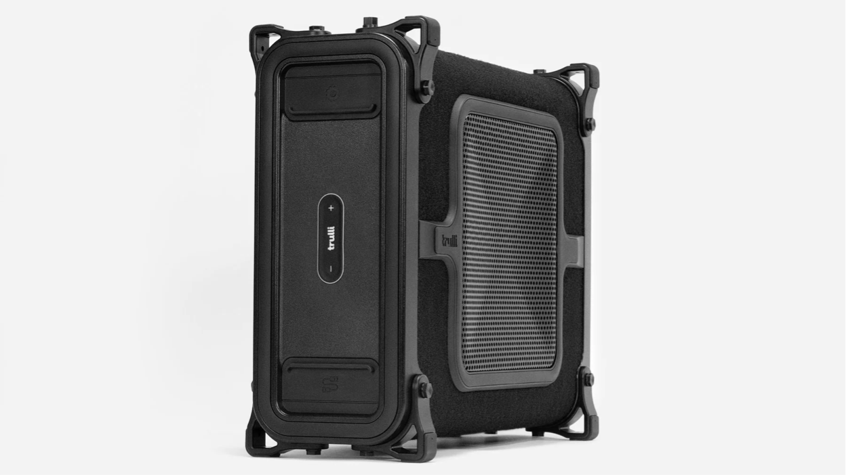
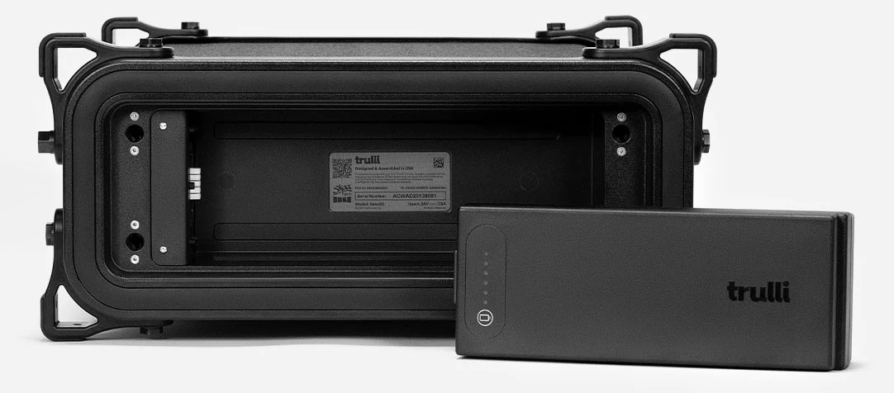
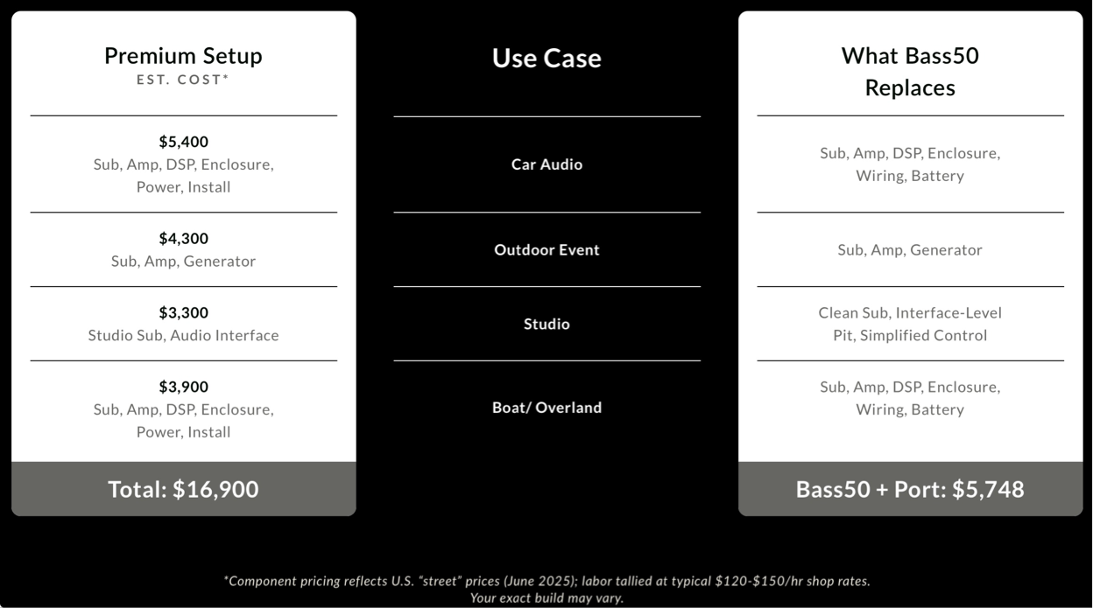
Trulli Bass50
https://trulliaudio.com/pages/bass50
$3899
No wires, no installations, no compromises.
A New Category of Sound. Most subwoofers are built for one specific use—home, studio, vehicle, or stage. The Trulli Bass50 was engineered to replace all of them..
桦木多层胶合板
【减分】SKAA协议组网；还未支持CarPlay/AA
10英寸、2ohm、600W
1000W peak @122dB
【减分】20-225Hz
磷酸铁锂 7-10hr full volume；40hr low volume
51*43*20cm；16KG
正在开发underseat版本
will offer three models using the same thin 10-inch woofer at 200 to 400W or 300 to 500W, 2ohms, 20 to 400Hz. $1899 to $2299
宣传文章
https://audioxpress.com/news/trulli-audio-introduces-bass50-world-s-first-battery-powered-thin-subwoofer
https://stupiddope.com/2025/08/trulli-audios-bass50-subwoofer-redefines-wireless-bass-no-installation-required/
https://www.edmtunes.com/2025/09/we-tested-trullis-bass50-subwoofer-we-love-it/
https://www.ceoutlook.com/2024/06/12/trulli-wireless-subwoofer-to-ship-sept/

Slide 28
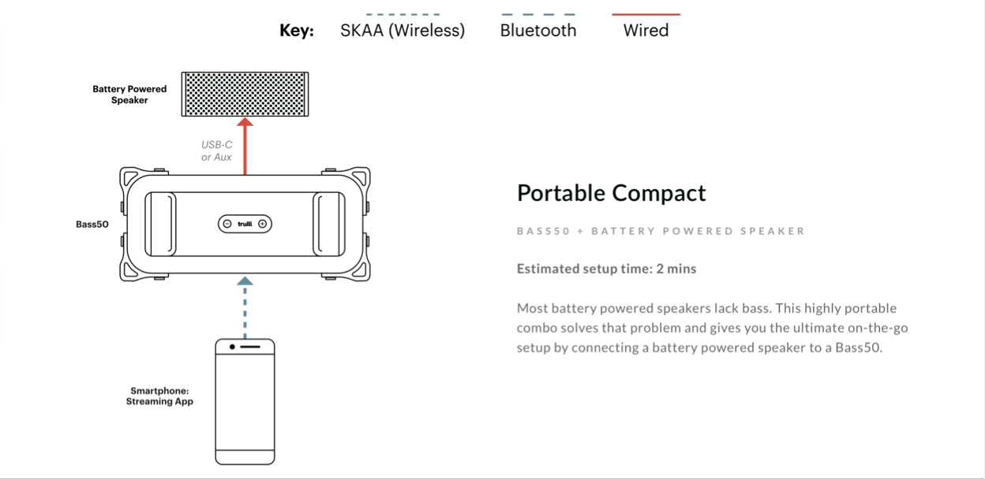
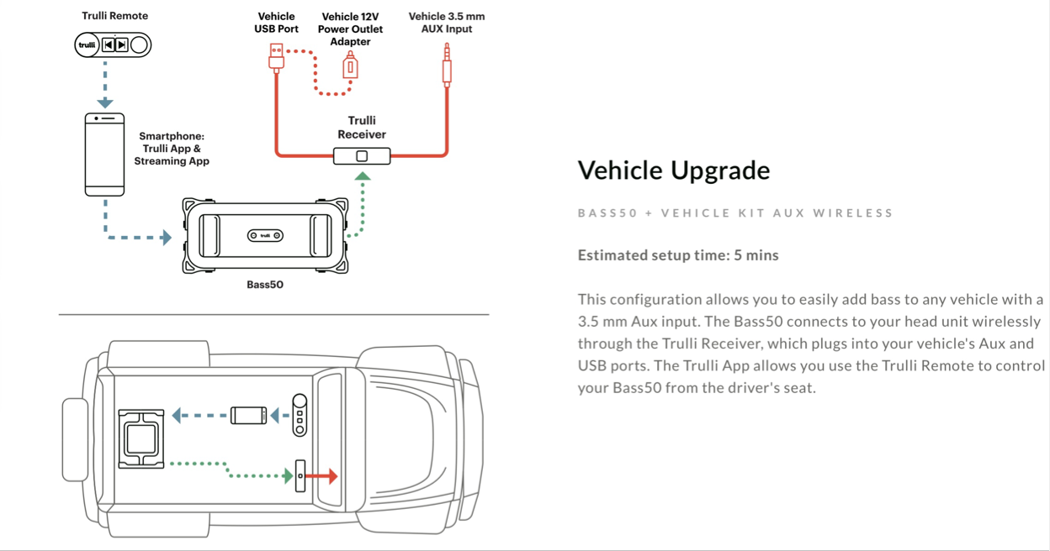
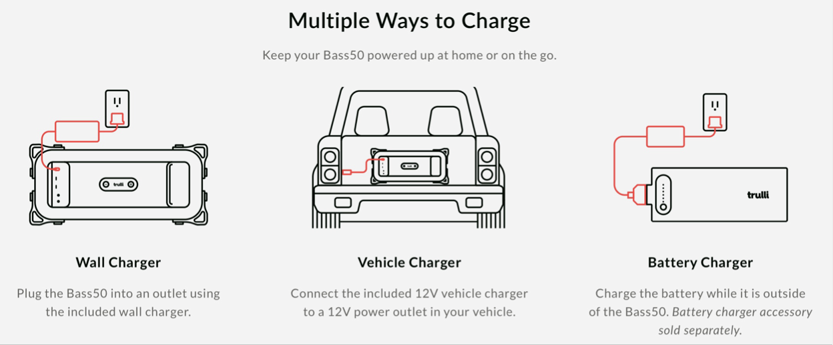
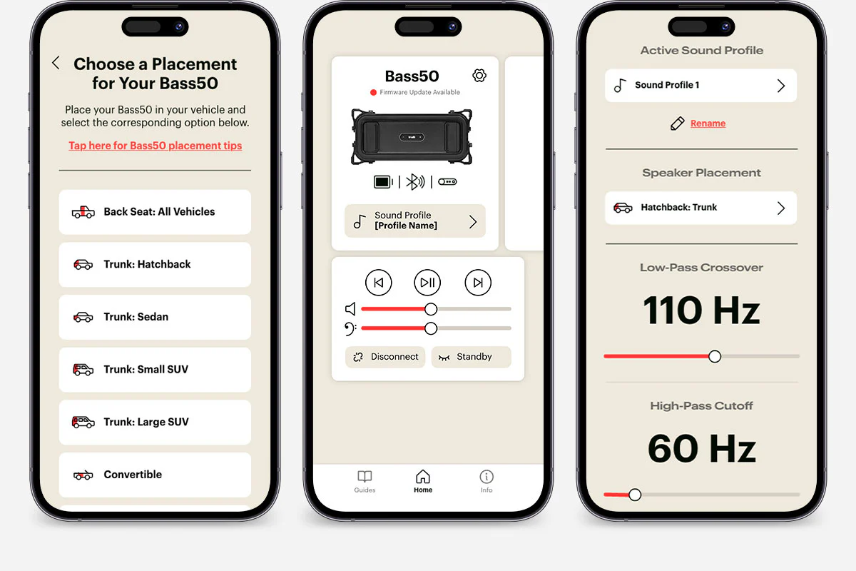

Slide 29
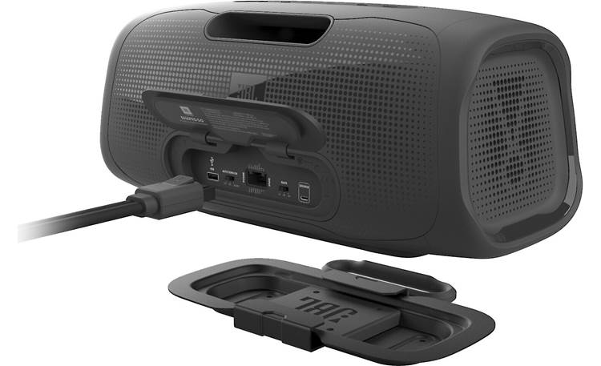
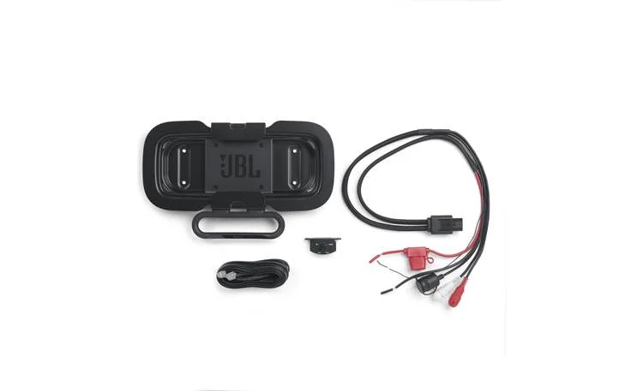
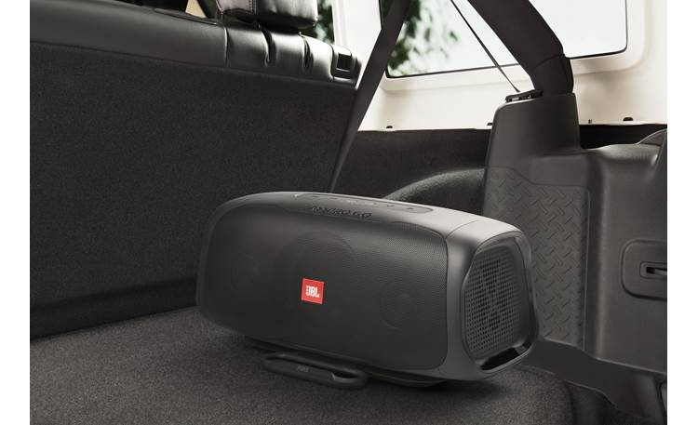
JBL BassPro Go
https://www.crutchfield.com/p_109BASPROG/JBL-BassPro-Go.html
https://www.amazon.com/JBL-BassPro-Vehicle-subwoofer-Full-Range/dp/B08XWVZSWR/
$470
多用途概念受欢迎，红点奖&IF奖
需要在车上单独钻孔螺接支架、需要接供电和信号线
抱怨：缺少家充；贵；连接不稳定；用到第二部车需要另外$110支架套件；
Crutchfield/Amazon缺货，可能在逐渐淡出市场
买家评论
https://www.crutchfield.com/p_109BASPROG/JBL-BassPro-Go.html

Slide 30
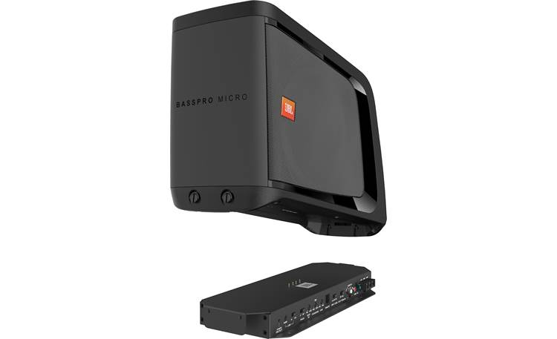
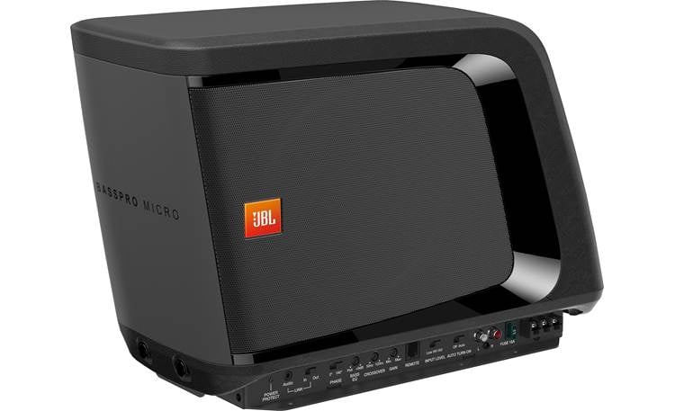
JBL BassPro Micro
https://www.crutchfield.com/S-CwR19Russ1p/p_109BASPROM/JBL-BassPro-Micro.html
比BassPro Go早发布一年
用户评价不错，但是2022年后还是停产了，重点反馈低频弱

Slide 31
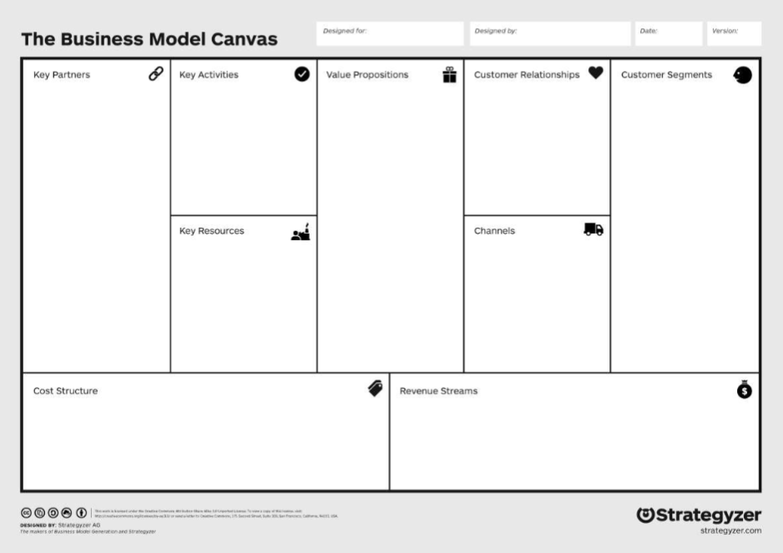
Should we do this? Business Model Canvas
Key Partners | Key Activities | Value Propositions |  | Customer Relationships 强调DIY支持：QR/PDF/TT/IG/reddit/FB/整合CRM | Customer Segments
 | Key Resources 声学、DSP/AI R&D能力 重点分零件制造 |  |  | Channels GTM Phase 1：D2C 汽车行业内同时做海外后装的朋友渠道 展会 PPC/TT/SEO/reddit 重点车型KOL
Cost Structure |  |  | Revenue Streams 北美C端市场：零售收入 国内汽车主机厂：现有车企客户的销售公司原厂改装、精品加装，批量及零售收入
TODO: 参考A2511内容复制、个别更新替换 https://365.kdocs.cn/l/cbMnYGePDcMy
GTM Strategy参考：https://gemini.google.com/app/bfa3bf7ae5df752e ，https://gemini.google.com/app/2cf8c1453de0238d

